Slide 1
Lecture 06: Memory Address Decoding

Slide 2
The 80x86 IBM PC and Compatible Computers
Chapter 10
Memory and Memory Interfacing
Chapter 11
I/O and the 8255

Slide 3
Terms about Memory - Revisit
Capacity: how many bits that a memory module contains
  E.g., 64M (bits)
Organization: how many bits can be accessed simultaneously (a memory unit, memory word) & thus how many words of a memory module
  E.g., 64M X 1, 16M X 4, 8M X 8
  2ª X d
Access time: how long does it take from putting the address on the address pins to getting the data from the data pins

Slide 4
Memory Address Decoding
According to your instructions that access memory
  E.g., MOV AX, [0012H]
CPU calculates the physical address and put corresponding signals on the address bus
  E.g., if DS=0900H, what’s the PA?
Memory address decoding circuitry locates the specific memory chip that stores the desired data
  Examine address decoding using logic gates and 74LS138 decoder chips

Slide 5
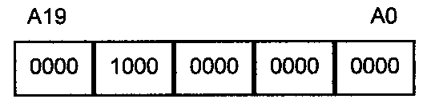
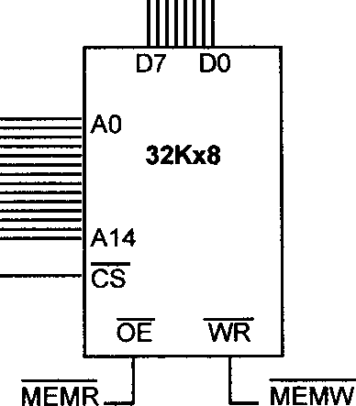
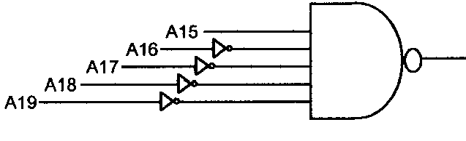
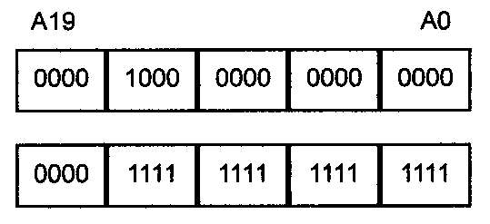


Memory Address Decoding
PA of 0900:0012 = 09012H

Slide 6
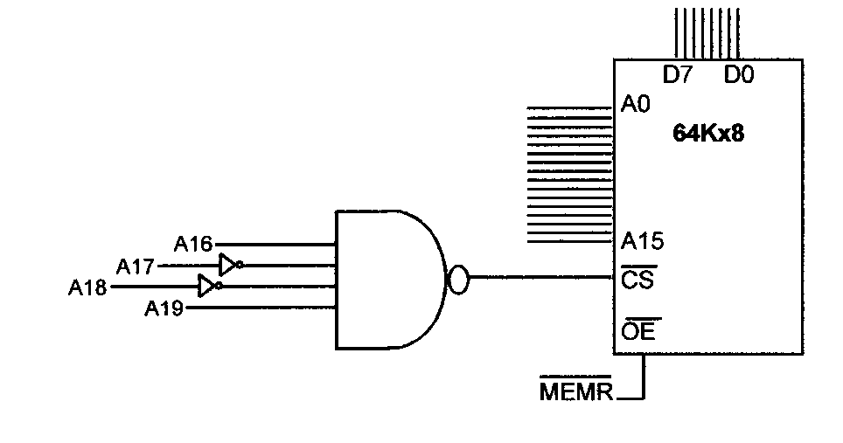

Quiz
What’s the address range?

Slide 7
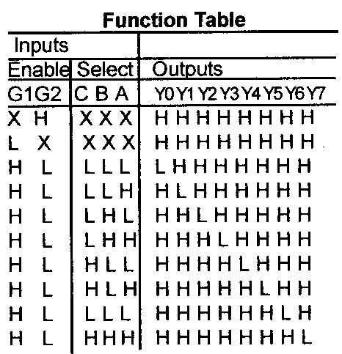
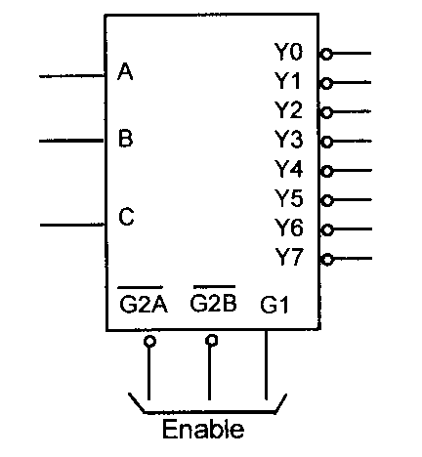

The 74LS138 Decoder Chip

Slide 8
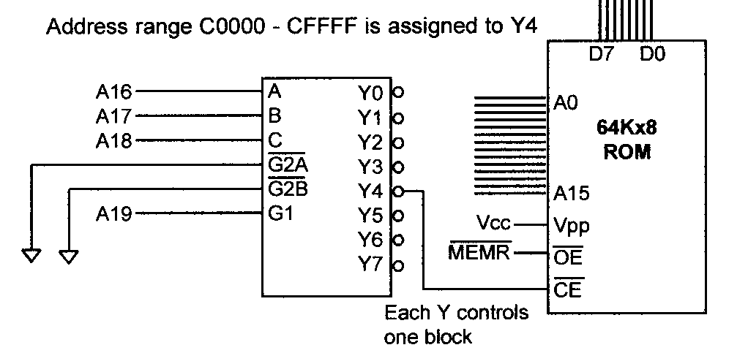
Using 74LS138 to Decode
Grounded

Slide 9
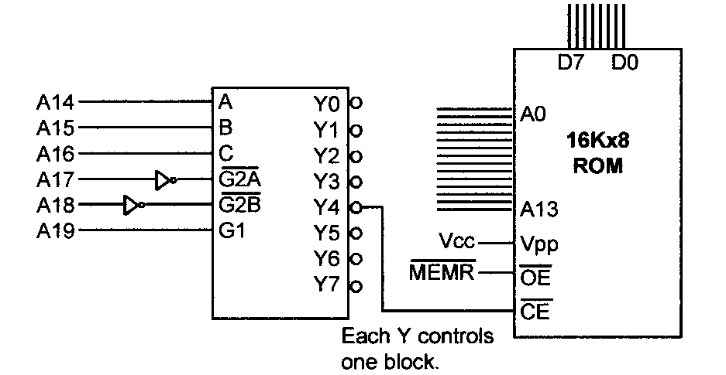


Quiz 2
What’s the address range for Y4 and Y7?

Slide 10
More on Address Decoding
Absolute address decoding
  All address lines are decoded
Linear select decoding
  Only selected lines are decoded
  Cheap
  But with aliases: the same memory unit (I/O port) with multiple addresses
    Why this happens?
Notes:
全译码
所有CPU高位地址线均参与对存储单元的译码寻址
低位地址线对芯片内各存储单元的译码寻址
片内译码
高位地址线对存储芯片的译码寻址
片选译码
每个存储单元的地址都是唯一的
不存在地址重复
部分译码
部分高位地址线参与对存储单元的译码寻址
存在地址段内容重叠
每个单元有多个地址

Slide 11
Example 1. In a particular computer, the address range from 0000h to 3FFFh is used for ROM, the range from 4000h to 5FFFh is reserved for future use, and the range from 6000h to 0FFFFh is used for RAM. Assume that the control signals for RAM are CS~ and WE~, and the CPU has 16 address pins (i.e., A15~A0), 8 data pins (i.e., D7~D0), and R/W~ and MREQ~ control signals. Achieve the following requests.
(1) draw the address decoding solution using a 74LS138 chip
(2) if both ROM and RAM are built with 8K×1 memory chips, try to draw the connection between the CPU and the memory.
(3) if ROM is built with 8K×8 memory chips and RAM is built with 4K×8 chips, try to draw the connection between the CPU and the memory.
(4) what if ROM is built with 16K×8 memory chips and RAM is built with 8K×8 memory chips?

Slide 12
(1) draw the address decoding solution using a 74LS138 chip
Solution.

Slide 13
(2) if both ROM and RAM are built with 8K×1 memory chips, try to draw the connection between the CPU and the memory.
Solution.

Slide 14
(3) if ROM is built with 8K×8 memory chips and RAM is built with 4K×8 chips, try to draw the connection between the CPU and the memory.
Solution.

Slide 15
(4) what if ROM is built with 16K×8 memory chips and RAM is built with 8K×8 memory chips?
Solution.

Slide 16
Example 2. Assume one computer system needs 512 byte RAM and 512 byte ROM. If RAM is built with 128×8 memory chips and ROM is built with 512×8 memory chips, please specify the address range of each memory chip. Given that RAM chips need CS~ and WE~ control signals, ROM chips need only CS~ control signal, and the CPU has 16 address pins (A15~A0), 8 data pins (D7~D0) and R/W~ and MREQ~ control signals, draw the connection between the CPU and the memory.
Solution. The address range of each memory chip：

Slide 17
As the total volume of the memory is 1K, we need 10 address lines. RAM chips need 7 address lines and ROM chips need 10 address lines.
MREQ#
A₇A₈A₉
OE#
3-8 decoder
A₁₅~A₀
&
A₆~A₀
R/W#
A₈~A₀
CPU
WE A CS
WE A CS
WE A CS
WE A CS
A CS
128x8
128x8
128x8
128x8
512x8
D₇~D₀
D₇~D₀
D₇~D₀
D₇~D₀
D₇~D₀
D₇~D₀

Slide 18
Data Integrity
Checksum byte for ROM
Parity bit for DRAM
CRC for disks and the Internet

Slide 19
Checksum Byte
Check the integrity of a series of bytes
  Calculation
    Add all bytes together and drop all carries
    Take the 2’s complement of the sum
  Store the checksum byte together with data
  check the integrity by adding data and the checksum together
  Then how to prove the integrity of the data?
  E.g., 38H, 23H, 33H, 07H, what is the checksum byte?
  6BH

Slide 20
Parity bit
Check the integrity of a series of bits (a byte)
  Calculation
    If even number of 1s, the bit is set

Slide 21
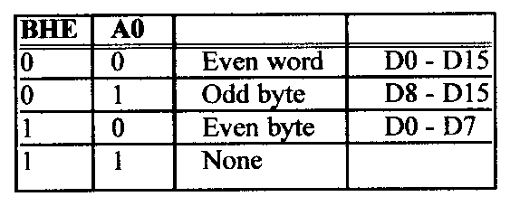
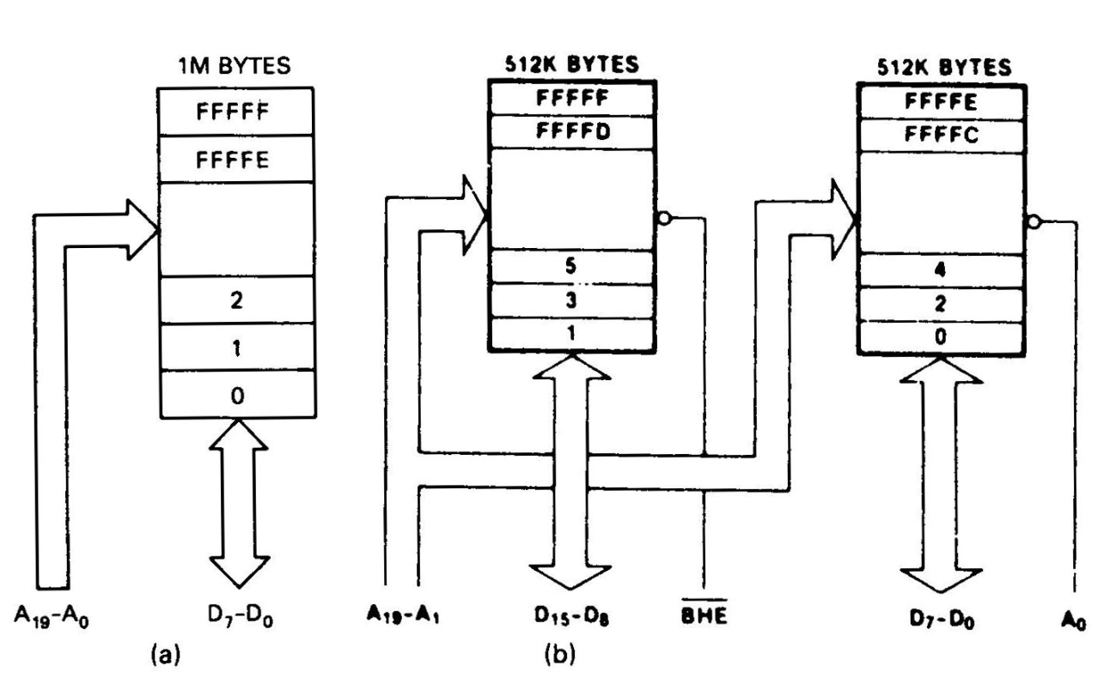
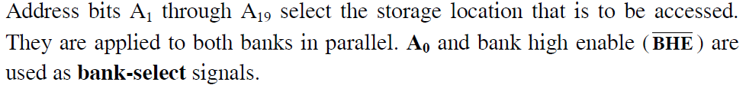
Memory Organization in 8086
Even and odd banks

Slide 22
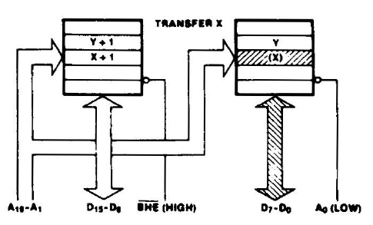
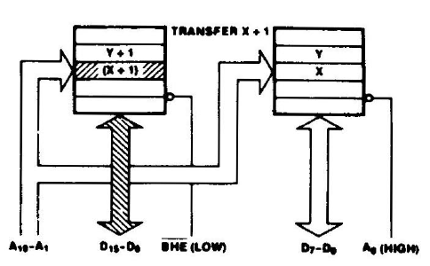
Byte-Memory Operations
Byte-memory operation at even address X
MOV AL, [100h]
Byte-memory operation at odd address X+1
MOV AL, [101h]

Slide 23
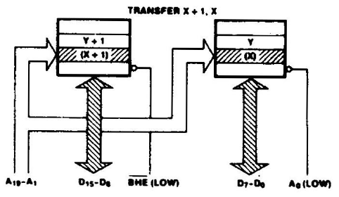

Aligned Word-Memory Operations
Accessing an aligned word at even address X
MOV AX, [100h]

Slide 24
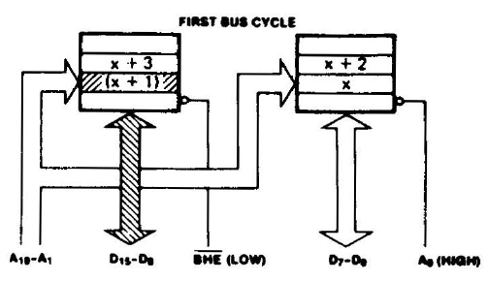
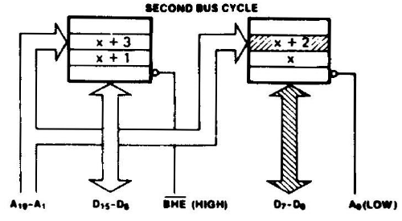
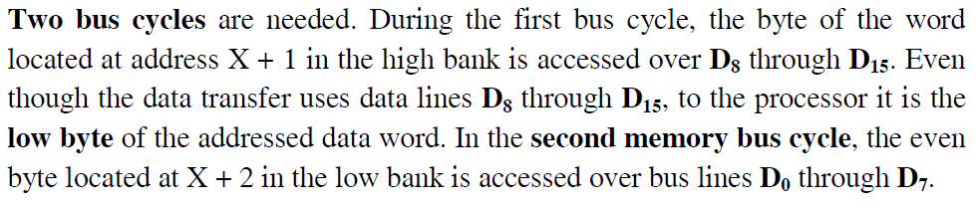
Misaligned Word-Memory Operations
Accessing an misaligned word at odd address X+1
MOV AX, [101h]

Slide 25
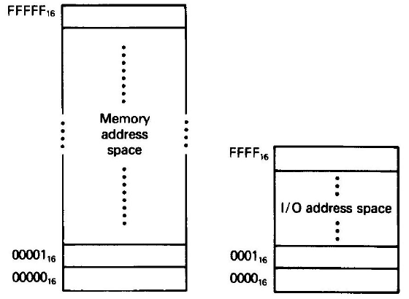
I/O in X86 family – The Other Space from Memory
X86 microprocessors have an I/O space in addition to memory space
Use special I/O instructions accessing I/O devices at ports (i.e., addresses for I/O)
Memory can contain machine codes and data, I/O ports only contain data
Also referred to as peripheral I/O or isolated I/O

Slide 26
I/O Instructions – 8-Bit Instance
Direct I/O instructions:
  port# ranges from 00h to 0ffh, 256 ports in total
Indirect I/O instructions:
  port# ranges from 0000h to 0ffffh, 65536 ports in all
  use a 16-bit address that resides in the DX register
Note: no segment concept for port addresses

Slide 27
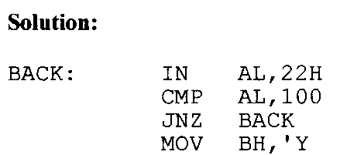
I/O Example
‘Y’

Slide 28
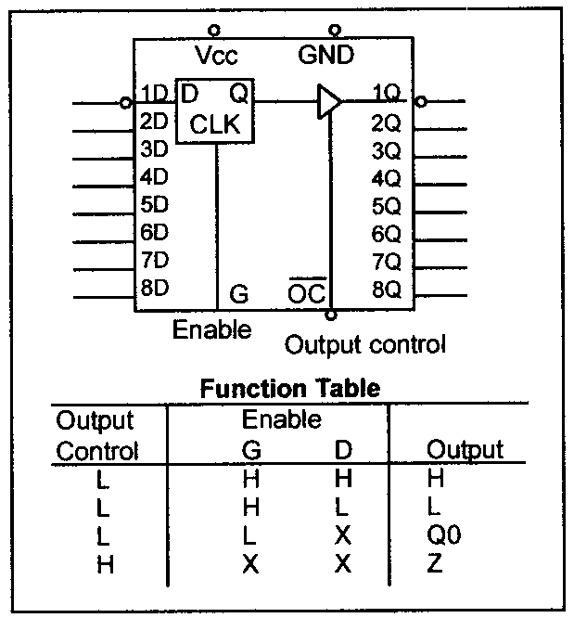
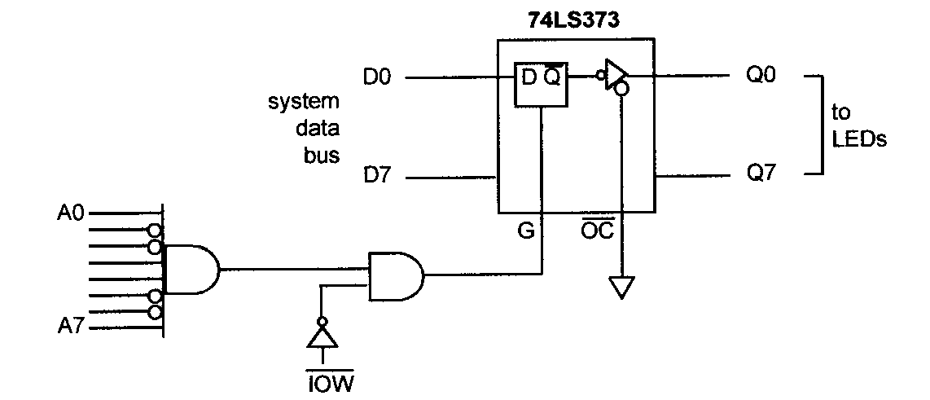

Output Port Design
Latch the data coming from the CPU
Address decoding
What is the address of this port?

Slide 29
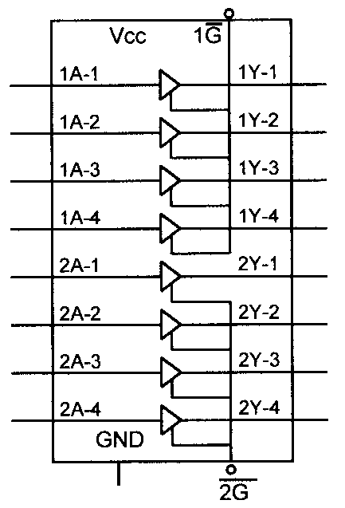
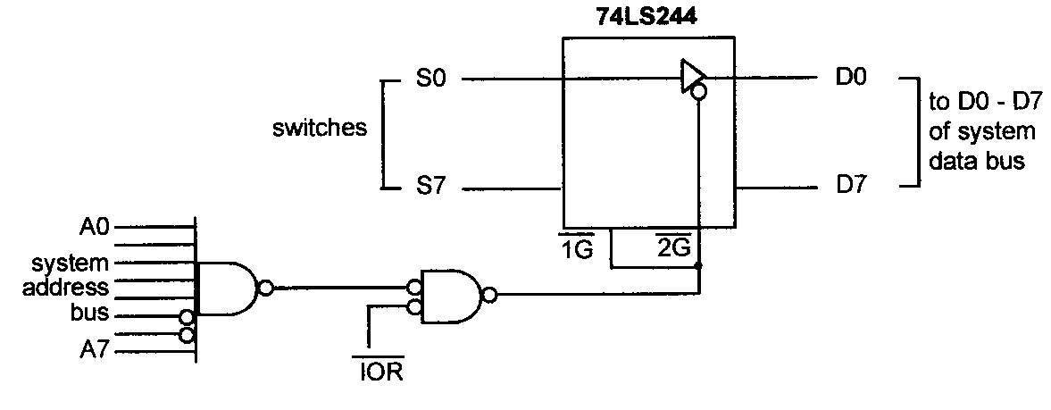
Input Port Design
Use tri-state buffer to connect to system data bus
Address decoding
What is the address of this port?

